Slide 1



DECEMBER 2019
ONLINE AUDIENCE
STUDY REPORT
.MD INTERNET POPULATION - 1 840 020

Slide 2


SEX
AUDIENCE COMPOSITION
SMTAI // DECEMBER 2019

Slide 3

AGE
AUDIENCE COMPOSITION
SMTAI // DECEMBER 2019

Slide 4

EDUCATION
AUDIENCE COMPOSITION
SMTAI // DECEMBER 2019

Slide 5
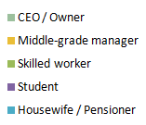
OCCUPATION
AUDIENCE COMPOSITION
SMTAI // DECEMBER 2019

Slide 6


URBAN / RURAL
AUDIENCE COMPOSITION
SMTAI // DECEMBER 2019

Slide 7

REGION
AUDIENCE COMPOSITION
SMTAI // DECEMBER 2018

Slide 8
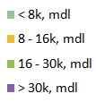
HOUSEHOLD NET INCOME
AUDIENCE COMPOSITION
SMTAI // DECEMBER 2019

Slide 9
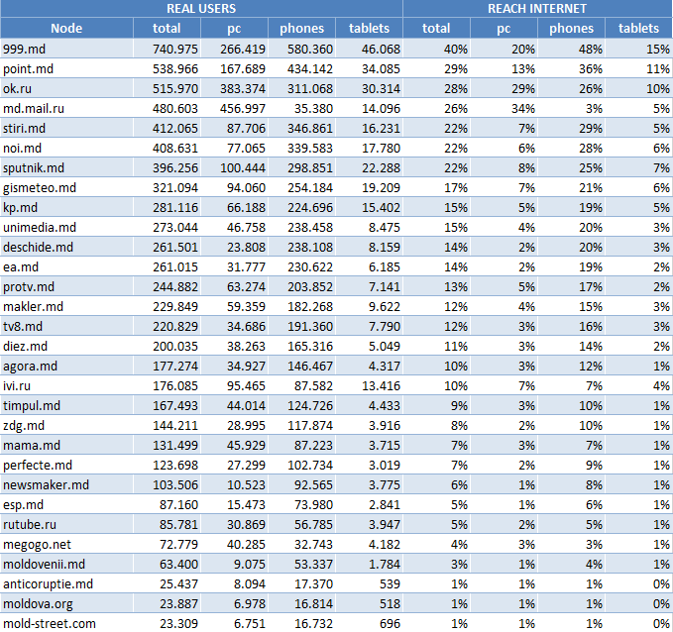
PLATFORM
AUDIENCE COMPOSITION
Platform | Population
PC | 1,335,439
Phone | 1,197,862
Tablet | 311,100
Total | 1 840 020
SMTAI // DECEMBER 2019

