Slide 1
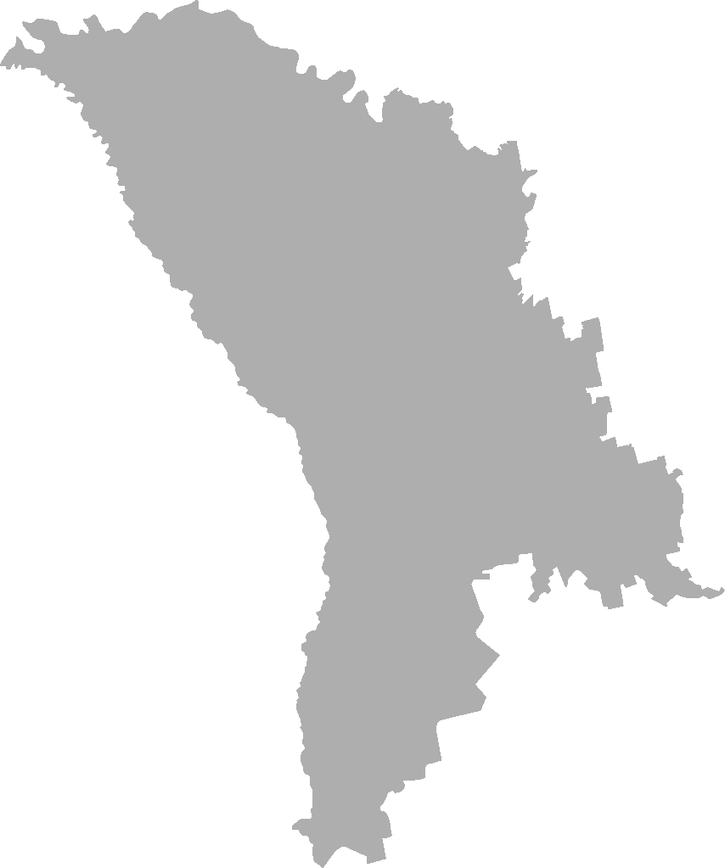


NOVEMBER 2020
ONLINE AUDIENCE
STUDY REPORT
.MD INTERNET POPULATION - 1 843 327
MOBILE + DESKTOP

Slide 2


SEX
AUDIENCE COMPOSITION
SMTAI // NOVEMBER 2020

Slide 3
SEX
AUDIENCE COMPOSITION
TOTAL / PC / MOBILE
 | women | men | women | men | women | men
Site | total |  | pc |  | phones
ea.md | 77% | 23% | 80% | 20% | 78% | 22%
rutube.ru | 77% | 23% | - | - | - | -
moldova.org | 67% | 33% | 65% | 35% | 68% | 32%
diez.md | 67% | 33% | 79% | 21% | 67% | 33%
moldovenii.md | 63% | 37% | 59% | 41% | 63% | 37%
ok.ru | 61% | 39% | 60% | 40% | 63% | 37%
timpul.md | 59% | 41% | 49% | 51% | 61% | 39%
perfecte.md | 58% | 42% | 44% | 56% | 63% | 37%
jurnal.md | 56% | 44% | 76% | 24% | 55% | 45%
ivi.ru | 56% | 44% | 55% | 45% | 59% | 41%
md.mail.ru | 55% | 45% | 56% | 44% | 48% | 52%
zdg.md | 55% | 45% | 51% | 49% | 56% | 44%
vk.com | 55% | 45% | 54% | 46% | 56% | 44%
tv8.md | 53% | 47% | 65% | 35% | 53% | 47%
jurnaltv.md | 53% | 47% | 67% | 33% | 48% | 52%
makler.md | 52% | 48% | 49% | 51% | 53% | 47%
noi.md | 51% | 49% | 37% | 63% | 54% | 46%
sputnik.md | 49% | 51% | 54% | 46% | 47% | 53%
stiri.md | 49% | 51% | 40% | 60% | 50% | 50%
unimedia.md | 48% | 52% | 47% | 53% | 49% | 51%
agora.md | 48% | 52% | 59% | 41% | 46% | 54%
gismeteo.md | 47% | 53% | 48% | 52% | 48% | 52%
nokta.md | 47% | 53% | 65% | 35% | 46% | 54%
europalibera.org | 46% | 54% | 57% | 43% | 41% | 59%
newsmaker.md | 45% | 55% | 57% | 43% | 44% | 56%
protv.md | 45% | 55% | 50% | 50% | 44% | 56%
999.md | 45% | 55% | 36% | 64% | 45% | 55%
mold-street.com | 44% | 56% | 30% | 70% | 47% | 53%
point.md | 43% | 57% | 35% | 65% | 43% | 57%
esp.md | 43% | 57% | 20% | 80% | 43% | 57%
megogo.net | 39% | 61% | 35% | 65% | 42% | 58%
kp.md | 37% | 63% | 46% | 54% | 37% | 63%
anticoruptie.md | 32% | 68% | 34% | 66% | 31% | 69%
rise.md | 29% | 71% | 34% | 66% | - | -

Slide 4

AGE
AUDIENCE COMPOSITION
SMTAI // NOVEMBER 2020

Slide 5
AGE
AUDIENCE COMPOSITION
PC / MOBILE
Site | [15-19] | [20-29] | [30-39] | [40-49] | [50+] | [15-19] | [20-29] | [30-39] | [40-49] | [50+]
 | pc |  |  |  |  | phones
anticoruptie.md | 0% | 26% | 31% | 14% | 29% | 9% | 17% | 34% | 29% | 11%
esp.md | 0% | 12% | 14% | 15% | 59% | 2% | 12% | 15% | 30% | 41%
rise.md | 0% | 23% | 39% | 1% | 36% | - | - | - | - | -
perfecte.md | 0% | 18% | 43% | 4% | 34% | 4% | 46% | 35% | 9% | 7%
rutube.ru | - | - | - | - | - | - | - | - | - | -
jurnaltv.md | 5% | 12% | 22% | 6% | 55% | 11% | 22% | 21% | 19% | 27%
kp.md | 0% | 20% | 15% | 26% | 40% | 2% | 18% | 14% | 23% | 43%
nokta.md | 1% | 31% | 34% | 13% | 22% | 1% | 5% | 18% | 25% | 52%
mold-street.com | 0% | 12% | 36% | 13% | 38% | 2% | 21% | 28% | 39% | 10%
moldova.org | 7% | 9% | 14% | 17% | 53% | 9% | 42% | 15% | 20% | 14%
noi.md | 0% | 6% | 17% | 16% | 61% | 10% | 20% | 26% | 19% | 26%
megogo.net | 2% | 47% | 17% | 17% | 17% | 12% | 40% | 14% | 18% | 17%
ivi.ru | 9% | 33% | 21% | 21% | 15% | 15% | 35% | 18% | 22% | 10%
moldovenii.md | 5% | 34% | 21% | 32% | 8% | 22% | 35% | 17% | 22% | 4%
makler.md | 8% | 29% | 18% | 19% | 26% | 10% | 35% | 27% | 17% | 11%
vk.com | 17% | 33% | 18% | 17% | 14% | 15% | 37% | 22% | 14% | 12%
ok.ru | 11% | 29% | 19% | 13% | 28% | 12% | 34% | 24% | 14% | 16%
newsmaker.md | 1% | 13% | 25% | 35% | 27% | 7% | 18% | 19% | 22% | 33%
md.mail.ru | 6% | 24% | 18% | 19% | 33% | 4% | 30% | 21% | 18% | 27%
jurnal.md | 4% | 22% | 22% | 14% | 38% | 14% | 28% | 25% | 16% | 18%
sputnik.md | 1% | 10% | 22% | 18% | 49% | 9% | 19% | 18% | 19% | 35%
tv8.md | 3% | 33% | 21% | 12% | 32% | 9% | 29% | 23% | 18% | 21%
diez.md | 14% | 53% | 4% | 9% | 20% | 25% | 31% | 22% | 15% | 7%
timpul.md | 17% | 22% | 9% | 25% | 28% | 17% | 32% | 19% | 25% | 7%
agora.md | 3% | 35% | 21% | 17% | 25% | 15% | 25% | 23% | 22% | 14%
protv.md | 0% | 23% | 31% | 10% | 36% | 11% | 23% | 29% | 22% | 16%
gismeteo.md | 1% | 12% | 13% | 21% | 53% | 8% | 22% | 29% | 19% | 22%
999.md | 7% | 24% | 30% | 21% | 18% | 10% | 38% | 25% | 18% | 9%
point.md | 2% | 18% | 35% | 21% | 23% | 8% | 25% | 22% | 22% | 23%
stiri.md | 2% | 14% | 33% | 21% | 30% | 10% | 27% | 26% | 18% | 19%
europalibera.org | 9% | 20% | 8% | 19% | 44% | 18% | 24% | 16% | 13% | 30%
ea.md | 15% | 37% | 19% | 8% | 21% | 21% | 34% | 27% | 10% | 7%
unimedia.md | 1% | 11% | 22% | 12% | 53% | 13% | 24% | 26% | 17% | 20%
zdg.md | 11% | 39% | 16% | 8% | 26% | 14% | 28% | 24% | 18% | 16%

Slide 6

EDUCATION
AUDIENCE COMPOSITION
SMTAI // NOVEMBER 2020

Slide 7
EDUCATION
AUDIENCE COMPOSITION
PC / MOBILE
Site | pc |  |  |  |  | phones
 | Middle | Specialized | Lyceum | College | University | Middle | Specialized | Lyceum | College | University
anticoruptie.md | 1% | 1% | 41% | 0% | 57% | 10% | 12% | 17% | 13% | 47%
europalibera.org | 4% | 18% | 16% | 10% | 52% | 17% | 13% | 26% | 6% | 38%
rise.md | 0% | 0% | 22% | 0% | 78% | - | - | - | - | -
perfecte.md | 8% | 0% | 8% | 10% | 74% | 7% | 21% | 26% | 1% | 45%
jurnaltv.md | 4% | 5% | 15% | 26% | 50% | 19% | 14% | 19% | 11% | 36%
nokta.md | 2% | 2% | 12% | 17% | 67% | 14% | 19% | 16% | 22% | 29%
mold-street.com | 0% | 1% | 25% | 22% | 52% | 17% | 9% | 26% | 2% | 46%
moldova.org | 4% | 19% | 6% | 14% | 57% | 8% | 12% | 39% | 6% | 36%
vk.com | 21% | 21% | 29% | 7% | 22% | 21% | 16% | 31% | 8% | 24%
makler.md | 6% | 12% | 31% | 6% | 46% | 20% | 22% | 27% | 6% | 25%
ivi.ru | 18% | 21% | 39% | 9% | 13% | 19% | 23% | 25% | 6% | 26%
megogo.net | 20% | 16% | 36% | 16% | 13% | 20% | 17% | 29% | 8% | 26%
moldovenii.md | 24% | 1% | 0% | 2% | 73% | 17% | 10% | 46% | 4% | 23%
noi.md | 9% | 27% | 8% | 7% | 49% | 8% | 17% | 21% | 11% | 43%
ok.ru | 18% | 27% | 29% | 11% | 15% | 16% | 23% | 31% | 10% | 21%
md.mail.ru | 11% | 18% | 21% | 8% | 42% | 8% | 19% | 19% | 10% | 43%
newsmaker.md | 3% | 19% | 14% | 3% | 62% | 13% | 20% | 15% | 12% | 39%
kp.md | 5% | 19% | 20% | 12% | 43% | 11% | 26% | 10% | 19% | 35%
jurnal.md | 4% | 7% | 22% | 7% | 60% | 14% | 18% | 26% | 6% | 36%
sputnik.md | 7% | 16% | 11% | 11% | 54% | 12% | 24% | 16% | 12% | 36%
tv8.md | 3% | 7% | 32% | 9% | 49% | 12% | 15% | 27% | 8% | 38%
diez.md | 2% | 8% | 53% | 6% | 31% | 19% | 16% | 35% | 7% | 23%
timpul.md | 14% | 20% | 9% | 6% | 50% | 13% | 16% | 38% | 6% | 27%
agora.md | 3% | 3% | 28% | 5% | 61% | 15% | 11% | 32% | 5% | 36%
protv.md | 6% | 4% | 18% | 7% | 65% | 11% | 16% | 25% | 8% | 41%
gismeteo.md | 13% | 15% | 15% | 9% | 48% | 17% | 20% | 18% | 9% | 35%
999.md | 15% | 15% | 23% | 7% | 40% | 17% | 20% | 31% | 6% | 27%
point.md | 11% | 20% | 13% | 6% | 51% | 11% | 20% | 21% | 9% | 37%
stiri.md | 6% | 8% | 21% | 9% | 57% | 13% | 16% | 26% | 10% | 36%
esp.md | 7% | 49% | 1% | 12% | 31% | 9% | 27% | 11% | 19% | 33%
ea.md | 3% | 7% | 27% | 4% | 58% | 16% | 13% | 30% | 2% | 40%
unimedia.md | 2% | 2% | 12% | 10% | 74% | 13% | 15% | 24% | 6% | 42%
zdg.md | 7% | 4% | 41% | 3% | 45% | 14% | 14% | 29% | 7% | 36%

Slide 8
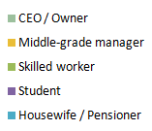
OCCUPATION
AUDIENCE COMPOSITION
SMTAI // NOVEMBER 2020

Slide 9
OCCUPATION
AUDIENCE COMPOSITION
PC / MOBILE
Site | Housewife / Pensioner | Student | Skilled worker | Middle-grade manager | CEO / Owner | Housewife / Pensioner | Student | Skilled worker | Middle-grade manager | CEO / Owner
 | pc |  |  |  |  | phones
anticoruptie.md | 2% | 1% | 1% | 79% | 17% | 8% | 22% | 12% | 20% | 38%
ea.md | 2% | 38% | 0% | 44% | 16% | 12% | 39% | 11% | 22% | 16%
rise.md | 1% | 0% | 0% | 39% | 60%
perfecte.md | 13% | 4% | 1% | 70% | 12% | 11% | 11% | 22% | 45% | 11%
nokta.md | 9% | 13% | 16% | 50% | 12% | 27% | 6% | 3% | 49% | 15%
mold-street.com | 28% | 14% | 0% | 44% | 15% | 6% | 15% | 10% | 27% | 42%
moldova.org | 23% | 13% | 14% | 14% | 37% | 16% | 18% | 4% | 30% | 32%
ok.ru | 33% | 26% | 17% | 17% | 6% | 27% | 32% | 19% | 18% | 4%
vk.com | 18% | 34% | 15% | 22% | 12% | 16% | 35% | 11% | 28% | 9%
makler.md | 31% | 11% | 4% | 42% | 12% | 18% | 24% | 10% | 36% | 12%
ivi.ru | 18% | 32% | 22% | 15% | 13% | 15% | 29% | 18% | 31% | 7%
megogo.net | 21% | 23% | 31% | 9% | 16% | 12% | 24% | 24% | 35% | 5%
noi.md | 27% | 5% | 6% | 44% | 18% | 20% | 15% | 9% | 40% | 16%
md.mail.ru | 20% | 17% | 10% | 40% | 13% | 17% | 15% | 11% | 47% | 10%
kp.md | 19% | 1% | 6% | 62% | 12% | 29% | 6% | 9% | 42% | 14%
newsmaker.md | 9% | 7% | 3% | 46% | 35% | 25% | 12% | 7% | 39% | 17%
jurnaltv.md | 38% | 16% | 3% | 35% | 8% | 21% | 31% | 2% | 27% | 19%
jurnal.md | 23% | 18% | 2% | 45% | 13% | 19% | 25% | 8% | 32% | 16%
sputnik.md | 24% | 6% | 6% | 51% | 13% | 28% | 13% | 5% | 37% | 17%
tv8.md | 15% | 23% | 5% | 28% | 28% | 22% | 20% | 8% | 31% | 19%
diez.md | 14% | 50% | 0% | 22% | 14% | 12% | 45% | 10% | 24% | 9%
timpul.md | 14% | 24% | 0% | 46% | 18% | 14% | 38% | 14% | 22% | 12%
agora.md | 9% | 28% | 1% | 40% | 22% | 18% | 28% | 7% | 33% | 14%
protv.md | 11% | 15% | 2% | 58% | 15% | 13% | 20% | 9% | 44% | 14%
gismeteo.md | 33% | 8% | 10% | 33% | 15% | 18% | 15% | 13% | 38% | 16%
999.md | 18% | 14% | 7% | 42% | 19% | 15% | 25% | 13% | 33% | 14%
europalibera.org | 26% | 18% | 2% | 41% | 13% | 26% | 25% | 4% | 27% | 18%
point.md | 15% | 7% | 8% | 49% | 21% | 20% | 15% | 11% | 38% | 16%
stiri.md | 19% | 6% | 6% | 50% | 19% | 22% | 19% | 12% | 34% | 13%
esp.md | 24% | 5% | 14% | 42% | 15% | 33% | 5% | 6% | 39% | 17%
unimedia.md | 21% | 10% | 1% | 47% | 21% | 12% | 25% | 9% | 37% | 17%
zdg.md | 12% | 30% | 3% | 42% | 13% | 16% | 26% | 10% | 36% | 12%

Slide 10


URBAN / RURAL
AUDIENCE COMPOSITION
SMTAI // NOVEMBER 2020

Slide 11
URBAN / RURAL
AUDIENCE COMPOSITION
PC / MOBILE
Site | Urban |  | Rural
 | pc | phones | pc | phones
ea.md | 54% | 46% | 46% | 54%
esp.md | 63% | 37% | 37% | 63%
europalibera.org | 51% | 49% | 49% | 51%
gismeteo.md | 49% | 51% | 51% | 49%
agora.md | 55% | 45% | 45% | 55%
jurnal.md | 44% | 56% | 55% | 45%
jurnaltv.md | 48% | 52% | 52% | 48%
kp.md | 51% | 49% | 50% | 50%
md.mail.ru | 53% | 55% | 46% | 44%
ok.ru | 47% | 53% | 53% | 47%
vk.com | 49% | 51% | 51% | 49%
makler.md | 47% | 53% | 53% | 47%
ivi.ru | 55% | 45% | 46% | 54%
megogo.net | 53% | 47% | 47% | 53%
noi.md | 55% | 45% | 48% | 52%
moldova.org | 44% | 56% | 53% | 47%
mold-street.com | 54% | 46% | 46% | 54%
newsmaker.md | 53% | 47% | 48% | 52%
nokta.md | 61% | 39% | 38% | 62%
sputnik.md | 51% | 49% | 49% | 51%
tv8.md | 52% | 48% | 47% | 53%
diez.md | 51% | 49% | 48% | 52%
timpul.md | 53% | 47% | 48% | 52%
perfecte.md | 49% | 51% | 51% | 49%
protv.md | 51% | 49% | 48% | 52%
rise.md | 97% | - | 3% | -
999.md | 53% | 47% | 46% | 54%
point.md | 56% | 44% | 45% | 55%
stiri.md | 51% | 49% | 44% | 56%
anticoruptie.md | 63% | 37% | 32% | 68%
unimedia.md | 58% | 42% | 43% | 57%
zdg.md | 47% | 53% | 54% | 46%

Slide 12

REGION
AUDIENCE COMPOSITION
SMTAI // NOVEMBER 2020

Slide 13
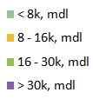
HOUSEHOLD NET INCOME
AUDIENCE COMPOSITION
SMTAI // NOVEMBER 2020

Slide 14
HOUSEHOLD NET INCOME
AUDIENCE COMPOSITION
PC / MOBILE
Site | <8k | 8k-16k | 16k- 30k | >30k | <8k | 8k-16k | 16k- 30k | >30k
 | pc |  |  |  | phones
anticoruptie.md | 4% | 15% | 74% | 7% | 38% | 19% | 26% | 17%
rise.md | 1% | 44% | 53% | 2%
mold-street.com | 38% | 17% | 29% | 16% | 37% | 35% | 25% | 3%
moldova.org | 39% | 36% | 20% | 5% | 50% | 33% | 11% | 6%
jurnal.md | 30% | 48% | 16% | 6% | 47% | 30% | 17% | 6%
jurnaltv.md | 49% | 36% | 10% | 5% | 49% | 32% | 13% | 5%
kp.md | 50% | 29% | 19% | 2% | 63% | 31% | 6% | 0%
md.mail.ru | 53% | 28% | 15% | 4% | 61% | 32% | 7% | 0%
ok.ru | 74% | 21% | 5% | 0% | 77% | 23% | 0% | 0%
vk.com | 51% | 30% | 10% | 9% | 53% | 37% | 8% | 2%
makler.md | 42% | 35% | 19% | 4% | 52% | 27% | 16% | 5%
ivi.ru | 72% | 14% | 11% | 3% | 72% | 17% | 10% | 0%
megogo.net | 77% | 18% | 5% | 0% | 74% | 22% | 4% | 0%
noi.md | 62% | 20% | 10% | 8% | 60% | 23% | 14% | 3%
agora.md | 42% | 29% | 19% | 10% | 42% | 30% | 21% | 7%
gismeteo.md | 54% | 26% | 15% | 5% | 51% | 30% | 16% | 3%
newsmaker.md | 40% | 27% | 21% | 12% | 52% | 30% | 16% | 2%
nokta.md | 40% | 48% | 9% | 4% | 73% | 22% | 3% | 2%
europalibera.org | 69% | 9% | 16% | 6% | 47% | 27% | 19% | 7%
sputnik.md | 57% | 30% | 10% | 3% | 56% | 29% | 12% | 3%
tv8.md | 48% | 20% | 17% | 15% | 53% | 24% | 16% | 7%
diez.md | 41% | 25% | 14% | 20% | 59% | 21% | 13% | 7%
timpul.md | 53% | 27% | 14% | 6% | 65% | 20% | 10% | 5%
perfecte.md | 29% | 45% | 22% | 4% | 42% | 30% | 18% | 10%
protv.md | 39% | 38% | 18% | 5% | 38% | 37% | 17% | 8%
esp.md | 41% | 30% | 17% | 12% | 59% | 28% | 10% | 3%
999.md | 42% | 31% | 22% | 5% | 50% | 28% | 18% | 4%
point.md | 37% | 35% | 20% | 8% | 45% | 36% | 17% | 3%
stiri.md | 36% | 24% | 29% | 11% | 53% | 28% | 15% | 4%
ea.md | 34% | 30% | 27% | 9% | 45% | 31% | 16% | 8%
unimedia.md | 44% | 31% | 18% | 7% | 50% | 25% | 21% | 4%
zdg.md | 29% | 23% | 43% | 5% | 50% | 29% | 17% | 4%

Slide 15
REAL USERS |  |  |  | REACH INTERNET
Site | total | pc | phones | total | pc | phones
999.md | 671.890 | 232.948 | 651.531 | 36% | 21% | 43%
point.md | 473.188 | 153.334 | 455.007 | 26% | 14% | 30%
stiri.md | 467.691 | 81.041 | 437.211 | 25% | 7% | 29%
md.mail.ru | 410.383 | 396.620 | 42.372 | 22% | 35% | 3%
tv8.md | 385.261 | 52.318 | 371.488 | 21% | 5% | 25%
ok.ru | 371.889 | 250.657 | 308.246 | 20% | 22% | 20%
jurnal.md | 356.485 | 39.919 | 341.328 | 19% | 4% | 23%
vk.com | 352.213 | 187.276 | 277.379 | 19% | 17% | 18%
zdg.md | 350.896 | 46.725 | 326.556 | 19% | 4% | 22%
newsmaker.md | 338.889 | 39.106 | 321.615 | 18% | 3% | 21%
gismeteo.md | 320.039 | 81.753 | 286.486 | 17% | 7% | 19%
sputnik.md | 284.162 | 82.725 | 227.818 | 15% | 7% | 15%
makler.md | 249.395 | 56.914 | 217.594 | 14% | 5% | 14%
protv.md | 242.739 | 63.662 | 231.978 | 13% | 6% | 15%
diez.md | 215.551 | 41.503 | 189.323 | 12% | 4% | 13%
noi.md | 213.411 | 54.737 | 176.145 | 12% | 5% | 12%
agora.md | 213.185 | 38.517 | 193.676 | 12% | 3% | 13%
unimedia.md | 196.507 | 40.542 | 178.780 | 11% | 4% | 12%
kp.md | 188.401 | 51.043 | 156.768 | 10% | 5% | 10%
ivi.ru | 188.309 | 84.218 | 124.149 | 10% | 7% | 8%
ea.md | 174.661 | 16.582 | 161.756 | 9% | 1% | 11%
timpul.md | 169.210 | 32.023 | 145.006 | 9% | 3% | 10%
esp.md | 145.655 | 24.794 | 134.879 | 8% | 2% | 9%
jurnaltv.md | 106.867 | 23.522 | 89.363 | 6% | 2% | 6%
perfecte.md | 90.287 | 27.364 | 75.213 | 5% | 2% | 5%
europalibera.org | 86.708 | 24.163 | 66.087 | 5% | 2% | 4%
megogo.net | 71.439 | 34.264 | 43.862 | 4% | 3% | 3%
nokta.md | 64.688 | 4.082 | 60.705 | 4% | 0% | 4%
moldova.org | 36.892 | 6.286 | 31.707 | 2% | 1% | 2%
anticoruptie.md | 32.639 | 6.399 | 26.332 | 2% | 1% | 2%
mold-street.com | 29.735 | 6.727 | 23.344 | 2% | 1% | 2%
rise.md | 22.126 | 3.708 | - | 1% | 0% | -
rutube.ru | 16.359 | - | - | 1% | - | -
PLATFORM
AUDIENCE COMPOSITION
Platform | Population
PC | 1 135 131
Phone | 1 508 815
Total | 1 843 327
SMTAI // NOVEMBER 2020

