Slide 1
# BATI #SMTAI 2020
ONLINE AUDIENCE STUDY
MOLDOVA
www.bati.md

Slide 2
Agencies & Websites
Online Audience Study
2020
999.MD
POINT.MD
PROTV.MD
PERFECTE.MD
STIRI.MD
RISE.MD
BUSINESSCLASS.MD
MOLDOVA.ORG
TV8.MD
UNIMEDIA.MD
SPUTNIK.MD
JURNAL.MD
NOI.MD
AGORA.MD
MOLDOVENII.MD
EA.MD
ZDG.MD
KP.MD
NEWSMAKER.MD
DOCDOC.MD
AQUARELLE.MD
NOKTA.MD
MAKLER.MD
JURANALTV.MD
MAKLER.MD
DIEZ.MD
GISMETEO.MD
RUTUBE.RU
IVI.RU
MEGOGO.NET
MAIL.RU
OK.RU
ESP.MD
ANTICORUPTIE.MD
MOLD-STREET.COM
TIMPUL.MD
www.trafic.md

Slide 3
Gender distribution
1.13 mln
Usage of internet on a daily basis(PC)
53% women
47% men
1.50 mln
Usage of internet on a daily basis(Mobile)
52% women
48% men
2.48 mln (15+)
1.88 mln (15+)
76%
Internet
Penetration
# SMTAI #gemiusAudience 2020

Slide 4
Age group distribution
TOTAL (ALL DEVICES)
2020
51 +
31-50
15-30
# SMTAI #gemiusAudience 2020

Slide 5
Age group distribution
PC
2019
2020
51 +
15-30
31-50
# SMTAI #gemiusAudience 2020

Slide 6
Age group distribution
MOBILE
2020
51 +
31-50
15-30
# SMTAI #gemiusAudience 2020

Slide 7
Age and Gender group distribution
2017
2015
2016
# SMTAI #gemiusAudience 2020

Slide 8
Age and Gender group distribution
MOBILE
2017
2015
2016
# SMTAI #gemiusAudience 2020

Slide 9
Personal income and
gender group distribution
42%
58%
> 15k mdl
41%
8 – 15k mdl
59%
46%
54%
4 – 8k mdl
58%
42%
< 4k mdl
# SMTAI #gemiusAudience 2020

Slide 10
Personal income and
gender group distribution
MOBILE
42%
58%
> 15k mdl
39%
8 – 15k mdl
61%
45%
55%
4 – 8k mdl
60%
40%
< 4k mdl
# SMTAI #gemiusAudience 2020

Slide 11
Education / Studies
and gender group distribution
58%
42%
33%.. Higher education
55%
45%
33%.. high school / college
47%
53%
34%.. primary/profes.

Slide 12
Education / Studies
and gender group distribution
MOBILE
58%
42%
34%.. Higher education
55%
45%
35%.. high school / college
47%
53%
32%.. primary/profes.
# SMTAI #gemiusAudience 2020

Slide 13
Main occupation
# SMTAI #gemiusAudience 2020

Slide 14
Main occupation
MOBILE
# SMTAI #gemiusAudience 2020

Slide 15
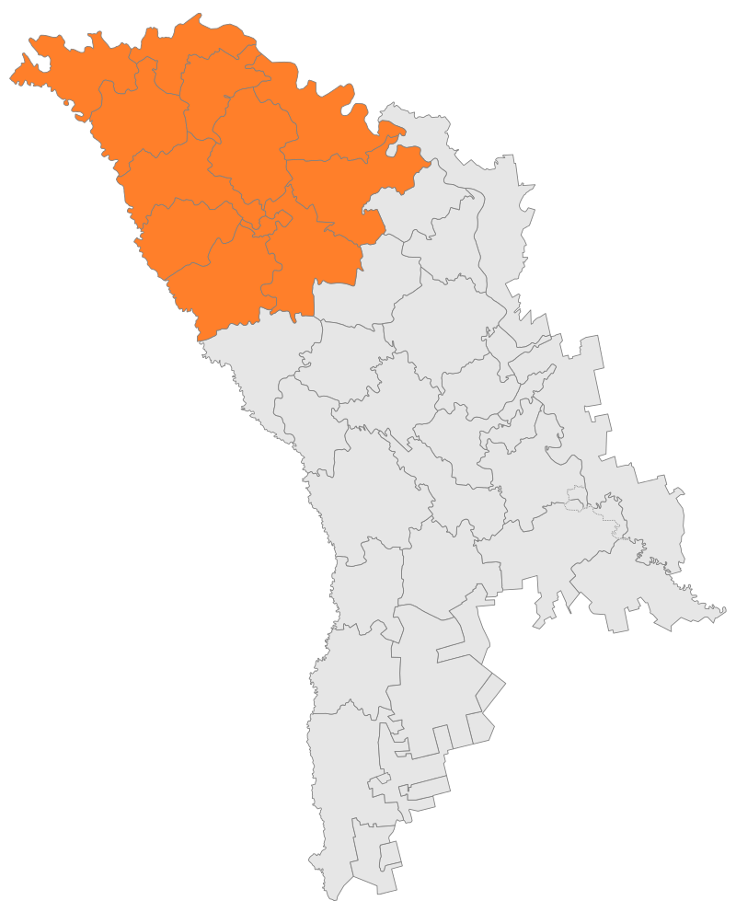
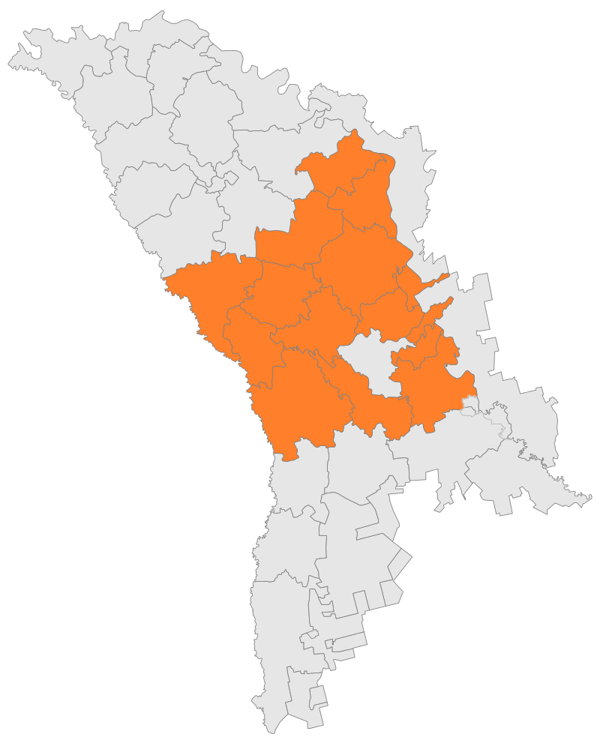
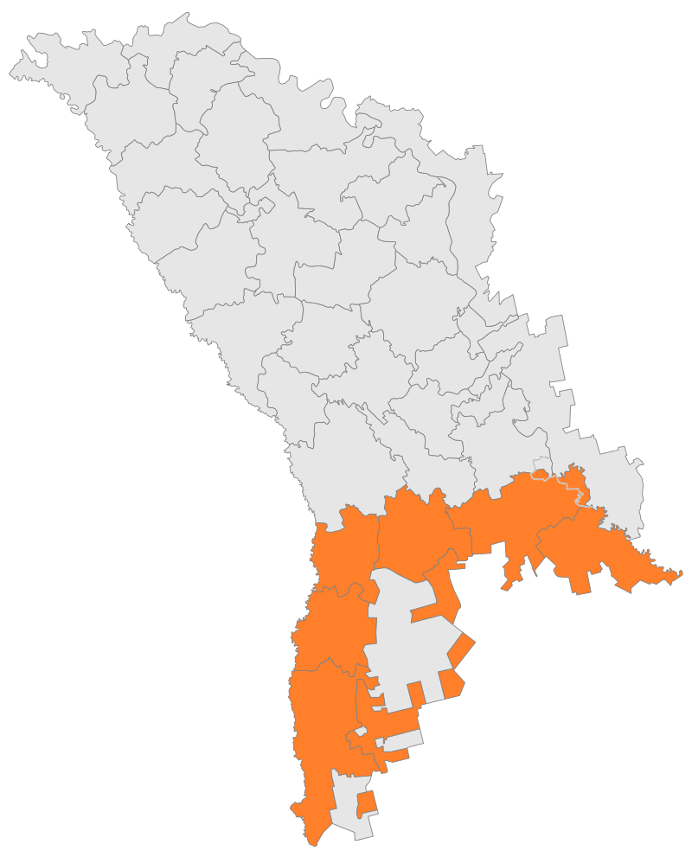
Internet Population by Regions
North Region
Central Region
South Region
25% incl. m. Balti
284K
59% incl. m. Chisinau
668K
16% incl. UTA Gagauzia
180K
# SMTAI #gemiusAudience 2020

Slide 16
Internet Population by Regions
North Region
Internet Users (thousands)
15-30
31-50
51 +
-33%
-34%
-33%
284k internet users
# SMTAI #gemiusAudience 2020

Slide 17
Internet Population by Regions
Central Region
Internet Users (thousands)
15-30
31-50
51 +
-36%
-36%
-28%
668k internet users
# SMTAI #gemiusAudience 2020

Slide 18
Internet Population by Regions
South Region
Internet Users (thousands)
15-30
31-50
51 +
-40%
-33%
-27%
180k internet users
# SMTAI #gemiusAudience 2020

Slide 19
Internet Population by Regions
MOBILE
North Region
Central Region
South Region
25% incl. m. Balti
202K
58% incl. m. Chisinau
464K
17% incl. UTA Gagauzia
131K
# SMTAI #gemiusAudience 2020

Slide 20
Internet Population by Regions
MOBILE
North Region
Internet Users (thousands)
15-30
31-50
51 +
-36%
-37%
-27%
202k internet users
# SMTAI #gemiusAudience 2020

Slide 21
Internet Population by Regions
MOBILE
Central Region
Internet Users (thousands)
15-30
31-50
51 +
-39%
-39%
-22%
464k internet users
# SMTAI #gemiusAudience 2020

Slide 22
Internet Population by Regions
MOBILE
South Region
Internet Users (thousands)
15-30
31-50
51 +
-47%
-35%
-19%
131k internet users
# SMTAI #gemiusAudience 2020

Slide 23
Online shopping
(e-commerce)
682K online buyers
Women – 55%
Men – 45%
# SMTAI #gemiusAudience 2020

Slide 24
Online shopping
(e-commerce)
MOBILE
507K online buyers
Women – 55%
Men – 45%
# SMTAI #gemiusAudience 2020

Slide 25
Online shopping
(e-commerce)
Categories of goods or services intended to purchase online
(thousands people)
# SMTAI #gemiusAudience 2020

Slide 26
Online shopping
(e-commerce)
Categories of goods or services intended to purchase online
(thousands people)
Mobile
# SMTAI #gemiusAudience 2020

Slide 27
What kind of information are searching
(thousands of people)
# SMTAI #gemiusAudience 2020

Slide 28
What kind of information are searching
(thousands of people)
Mobile
# SMTAI #gemiusAudience 2020

Slide 29
Products intended to be purchased
in the next 12 months
# SMTAI #gemiusAudience 2020

Slide 30
Products intended to be purchased
in the next 12 months
Mobile
# SMTAI #gemiusAudience 2020

